Slide 1
Online Resource Repository Building a Digital Library for the Future
Presented By: Marzana Akter Anika - 221002489
Md. Arif Billah - 221002520
Presented To :
Kazi Hasnayeen Emad
Lecturer
Green University Of Bangladesh

Slide 2
Overview
Introduction
Objective
Methodology
Tools & Technologies
Design interface
Key Feature
Conclusion

Slide 3
Introduction
In the current era of digital transformation, access to information has become more essential than ever. The Digital Library project aims to create an online platform where users can access a wide range of digital books, journals, and other educational resources.

Slide 4
Objectives
The project aims to:
Provide a digital platform for educational resources.
Implement search functionality for efficient navigation.
Ensure user authentication and content protection.
Enable access across devices and browsers.
Support administrators in content management.

Slide 5
Methodology
The project was divided into the following stages:
Requirement Analysis: Identify stakeholder needs.
Design Phase: Create wireframes and prototypes.
Development Phase: Code and integrate components.
Testing & Deployment: Ensure functionality and launch the site.

Slide 6
Tools & Technologies (Front End)
Front-End:
HTML: Structure the web content.
CSS: Style and design.
JavaScript: Add interactivity (search, filters).

Slide 7
Tools & Technologies(Back End)
Back-End:
PHP: Handle server-side operations.
MySQL: Manage the database.
Apache/Nginx: Web server hosting.

Slide 8
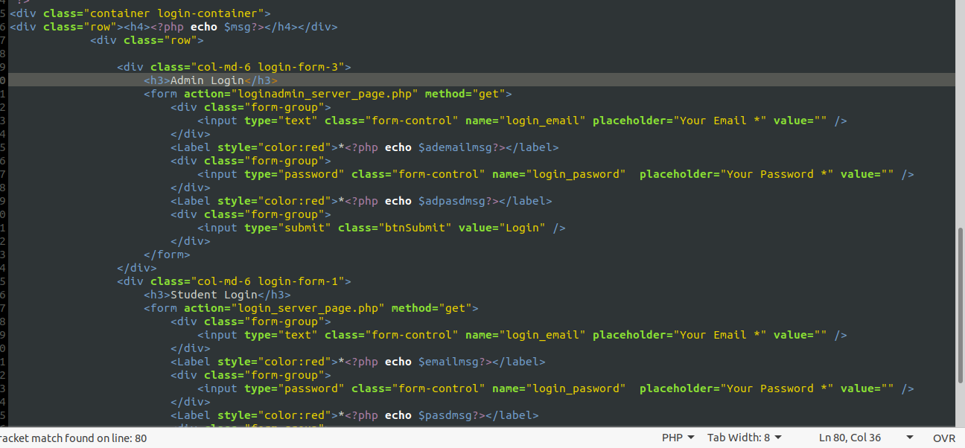
Design Interface

Slide 9
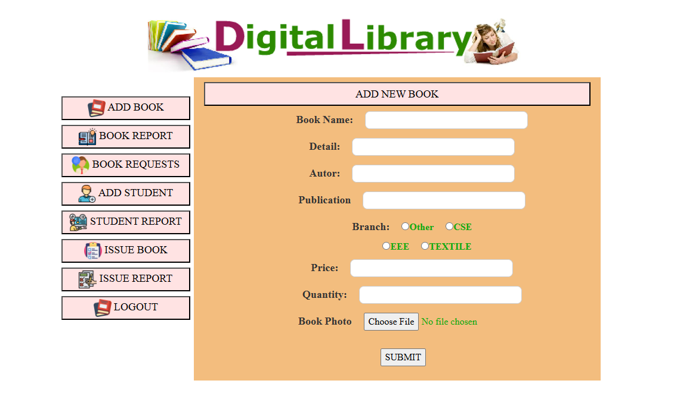
Design Interface

Slide 10
Key Features
User-Friendly Interface: Easy navigation and accessibility.
Search Functionality: Find books/resources efficiently.
Resource Upload: Upload book details, price, and quantity.
Authentication: Secure user login.
Admin Panel: Manage books and student reports.

Slide 11
Conclusion
The Digital Library project will provide an accessible platform for users to browse and download a variety of educational resources. Built with a combination of modern web technologies such as HTML, CSS, JavaScript, and PHP, this website will offer a seamless user experience, secure access to materials, and an intuitive management system for administrators.

Slide 12
Thank You ! Have a nice day !!
Data encryption is the process of transforming information into an unreadable form, ensuring that only authorized parties can access and understand it.

